Slide 1
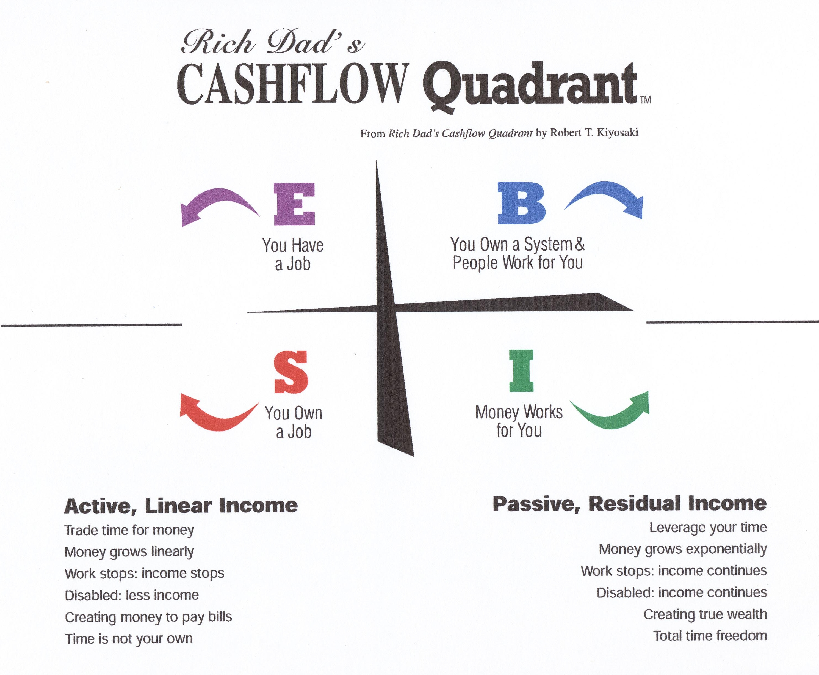

Slide 2

Copyright © 2012 Market America

Slide 3
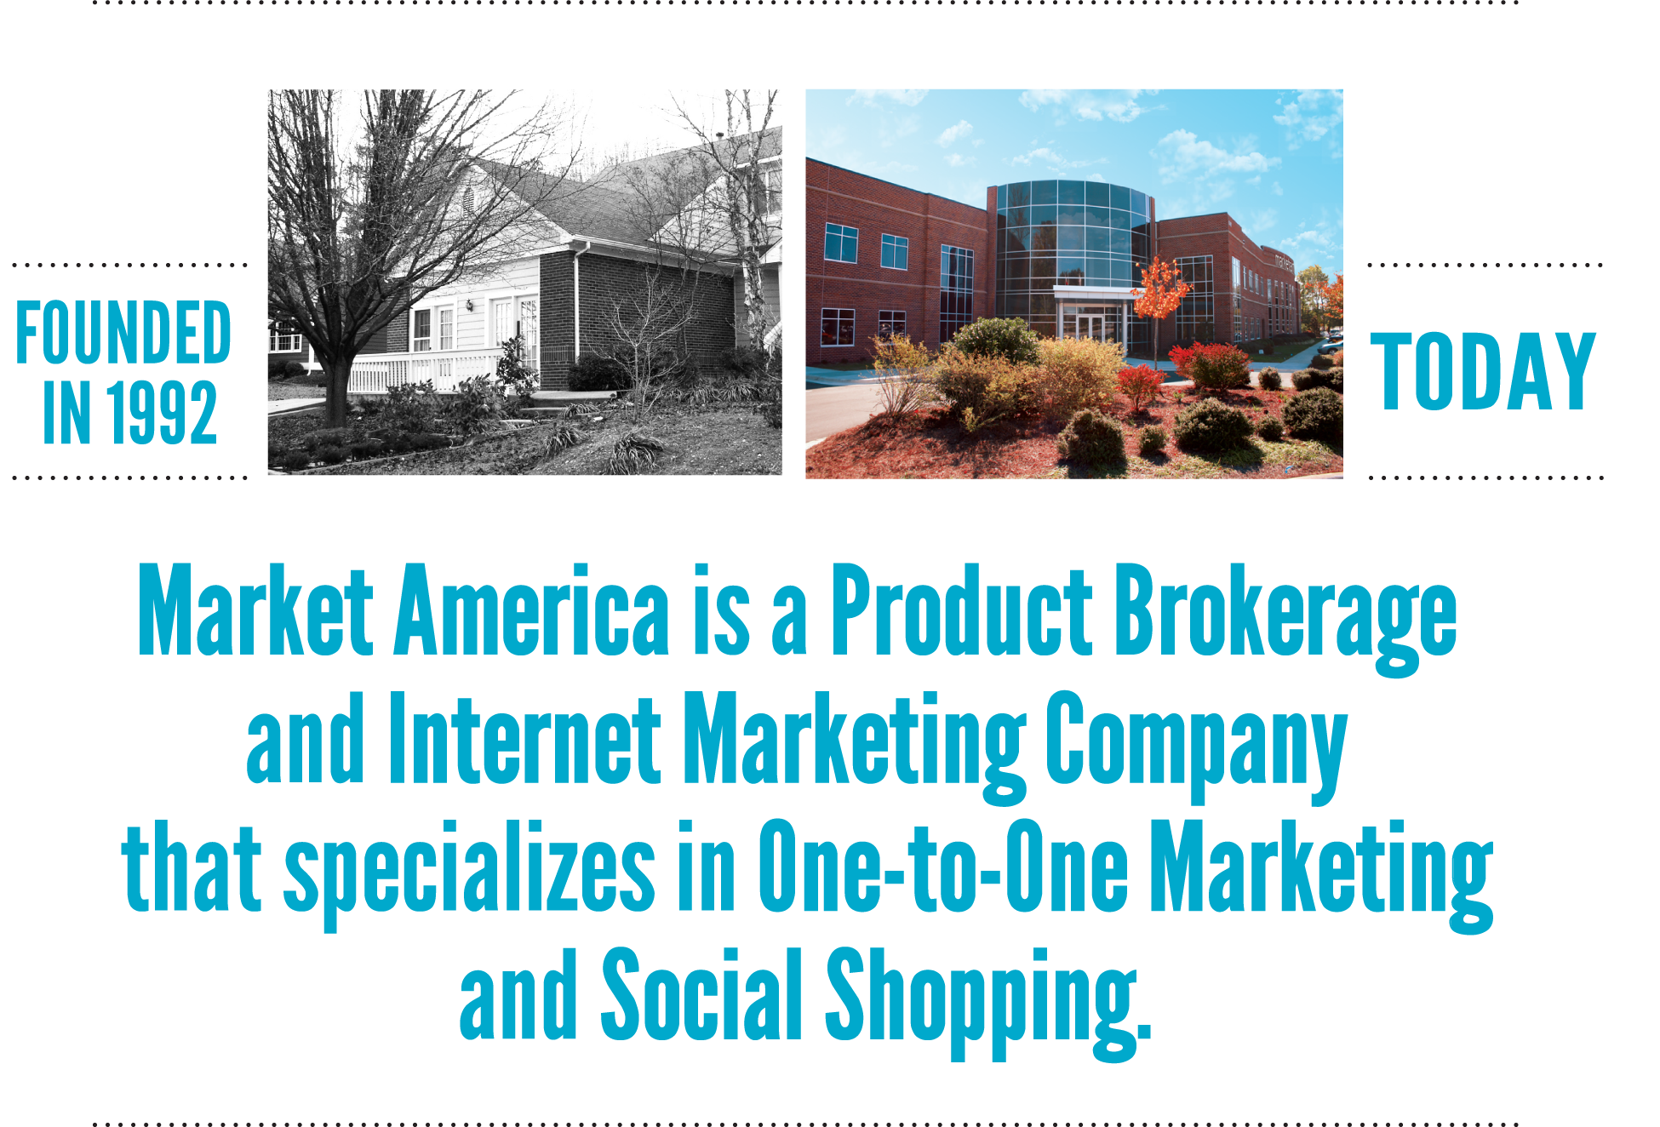

Slide 4
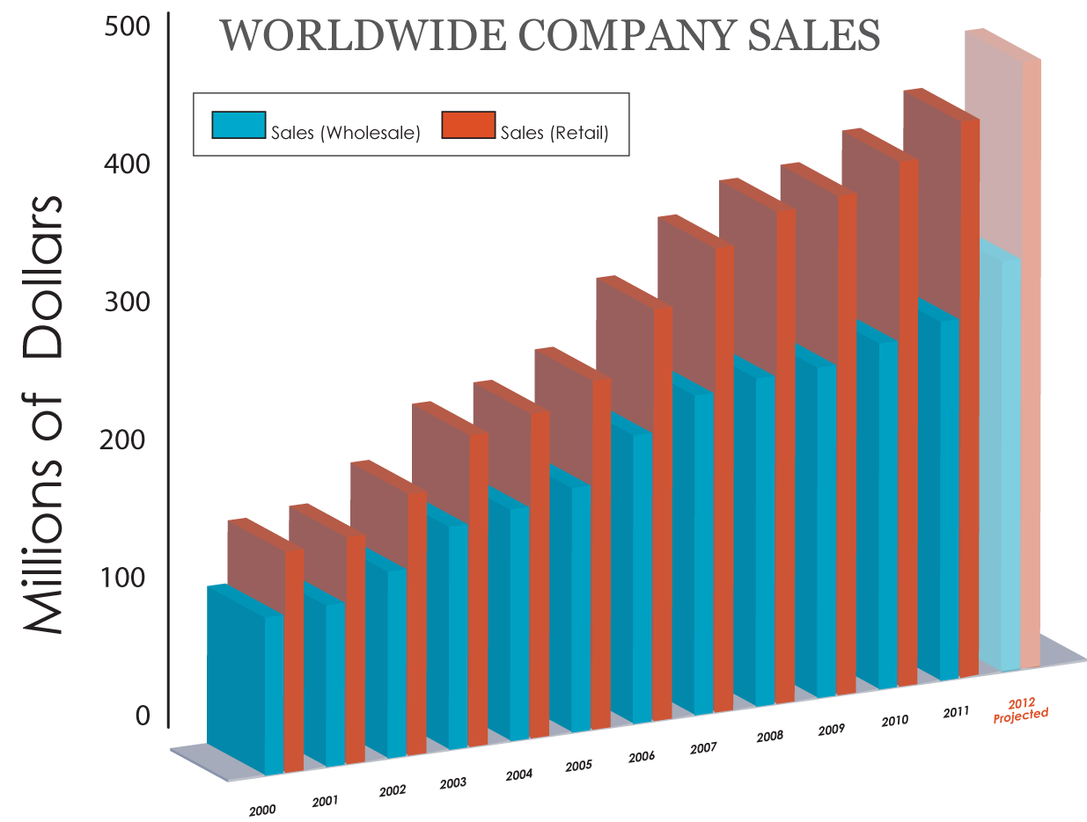
Estimated accumulated retail sales:
$4,420,703,988*
*As of March 31, 2012 (since the companies’ inception)
Notes:
4

Slide 5






















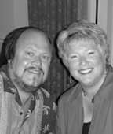











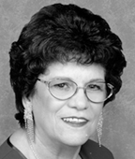













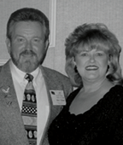
Market America | SHOP.COM is changing the way that people shop and changing the economic paradigm so everyone can become financially independent by creating their own economy.
Total estimated retail profits earned†:
$1,265,058,282
+
Total commissions earned:
$1,257,468,708
=
Total Distributor earnings:
$2,522,526,990*
*As of March 31, 2012. †Estimated retail profits based on suggested retail price

Slide 6
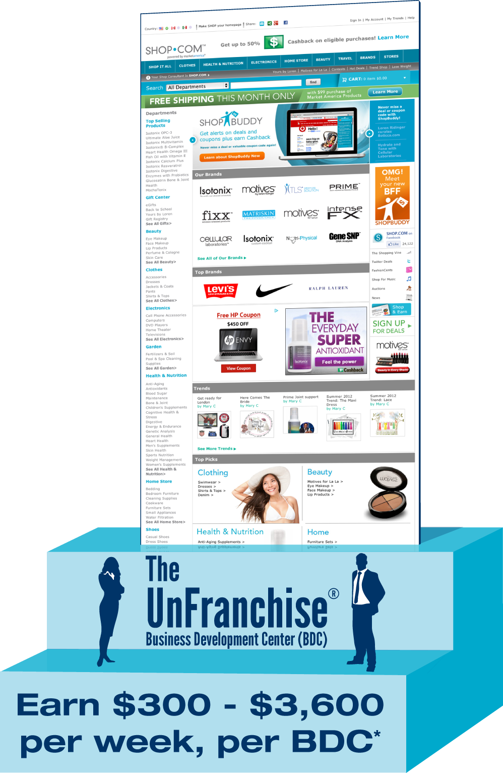
LIKE A FRANCHISE:
• Systemization, standardization, uniformity
• State-of-the-art management systems
• Merchandising and marketing tools
• Standardized training systems
• Potential tax advantages
• Growing visibility
UNLIKE A FRANCHISE:
• No franchise fees
• No monthly royalties
• No territorial restrictions
• Start part time with flexible hours
• Minimal startup expenses
• Little Risk

Slide 7

Entertainment
Miscellaneous
Health Care
Transportation
Personal Care Products and Services
Gifts of Goods and Services
FOOD
Apparel and Services

Slide 8
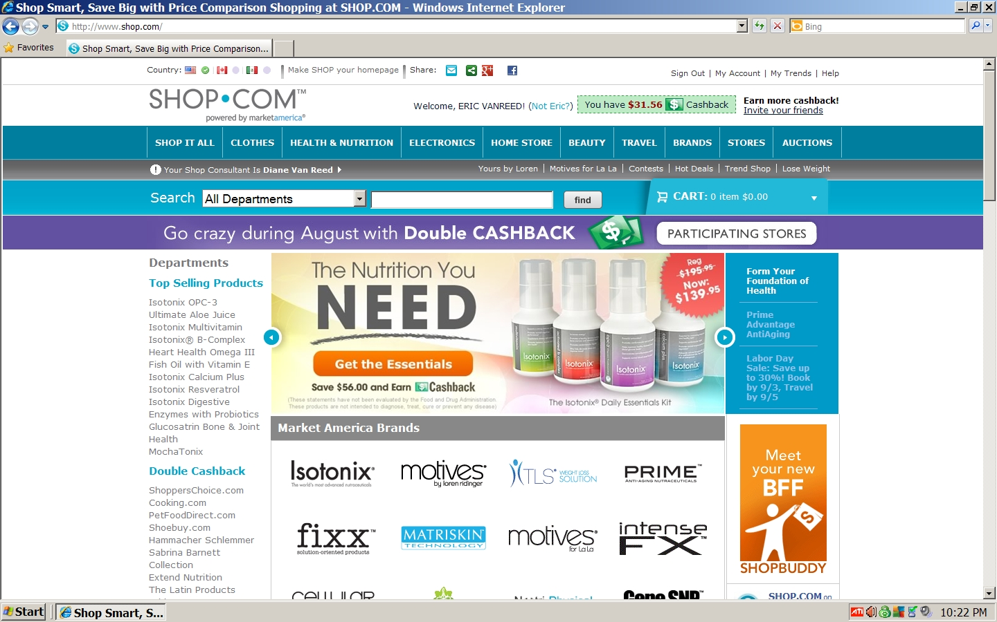

Slide 9
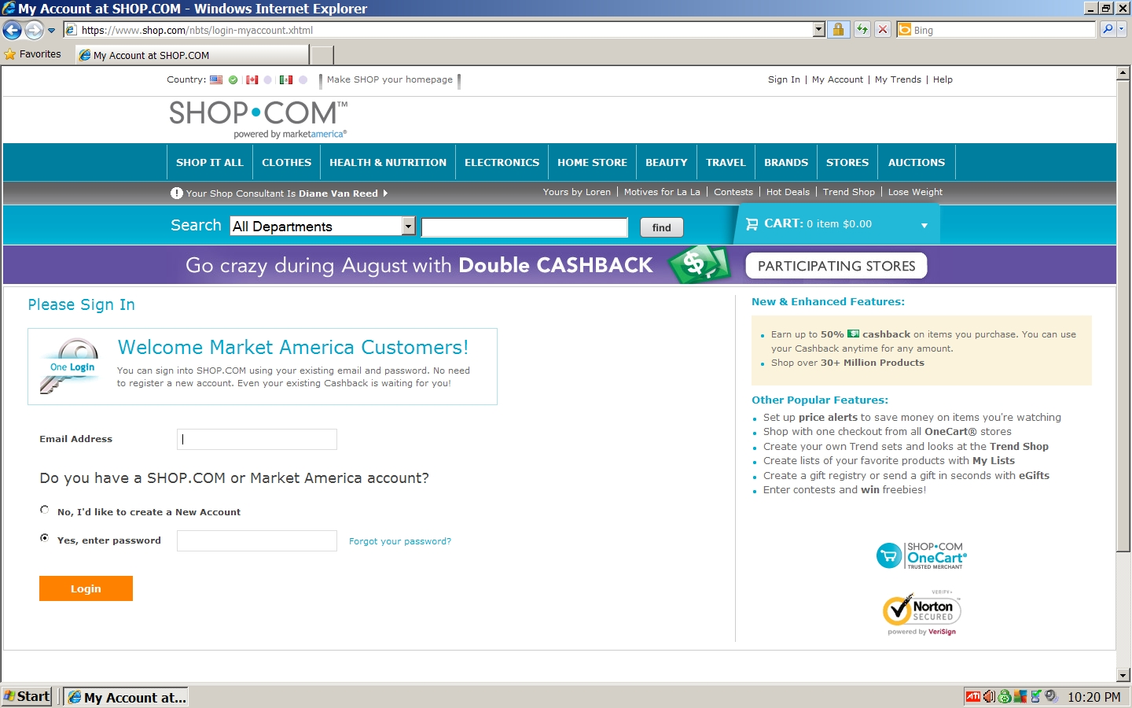

Slide 10
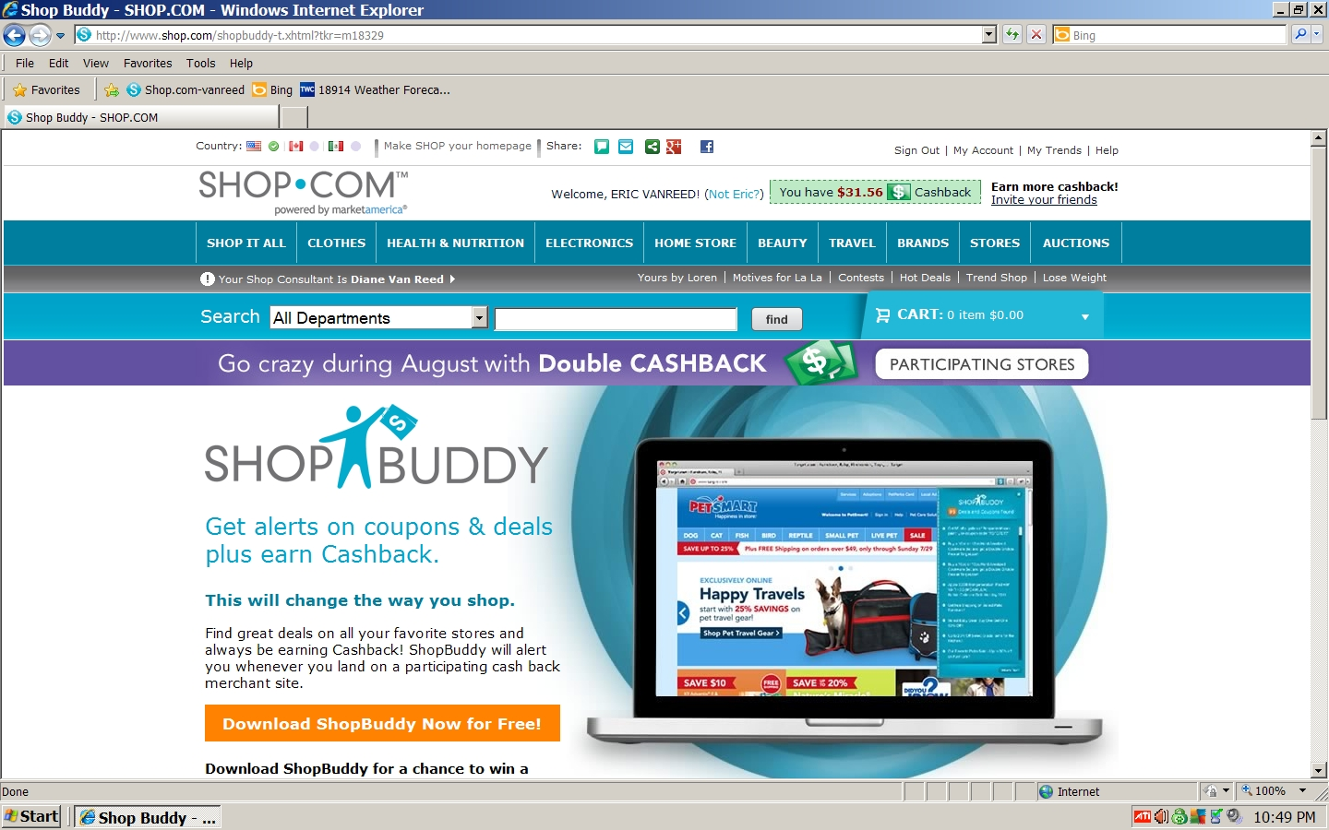

Slide 11
• Identifies the latest market-driven products
• Eliminates the burden of manufacturing
• Does not rely solely on the sales of any one
product or service
• Hundreds of exclusive products and services
• Access to multibillion dollar markets

Slide 12
























Slide 13
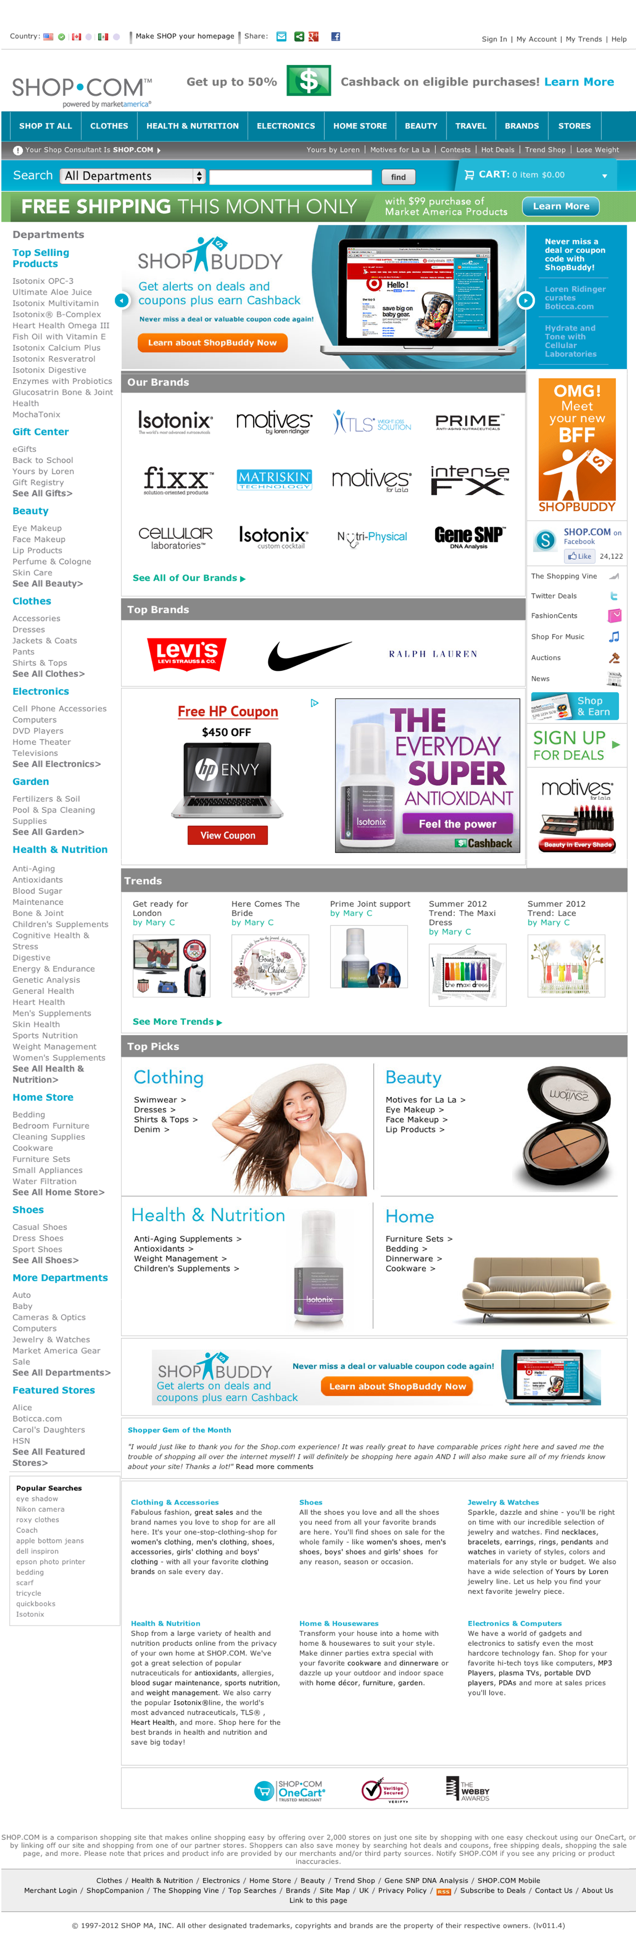


Hot Deals
Hundreds of Exclusive ma® Brands
eGifts
Social Networking
ShopBuddy
Earn up to 50 percent cash back for purchasing Market America branded products and those from our Partner Stores where you see the Cashback logo
Earn ½ percent on referral purchases forever

Slide 14
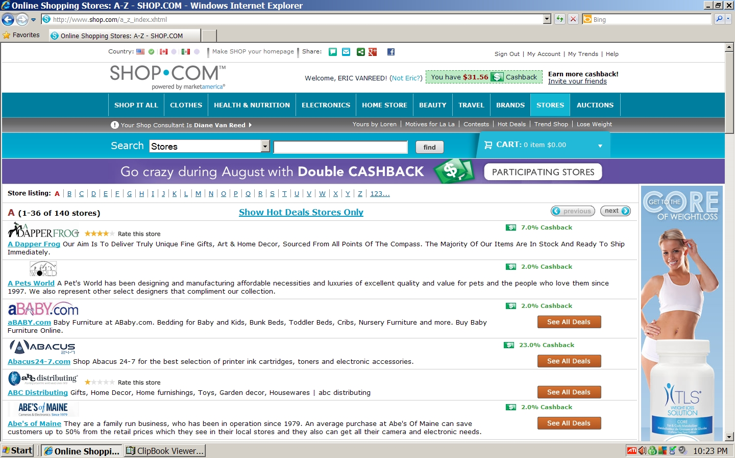

Slide 15
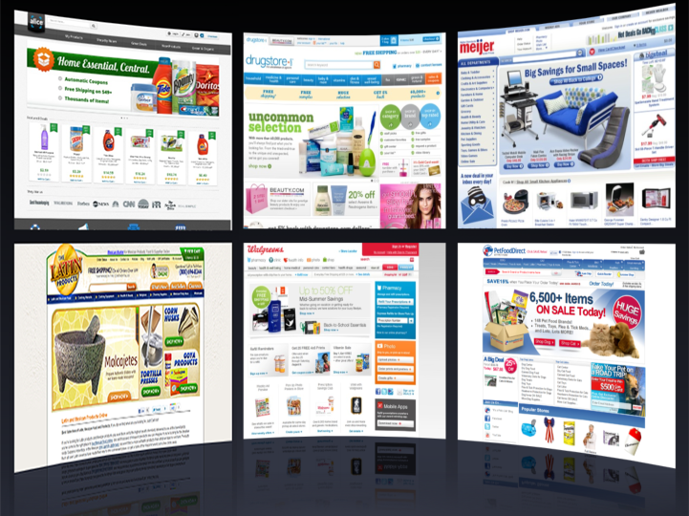
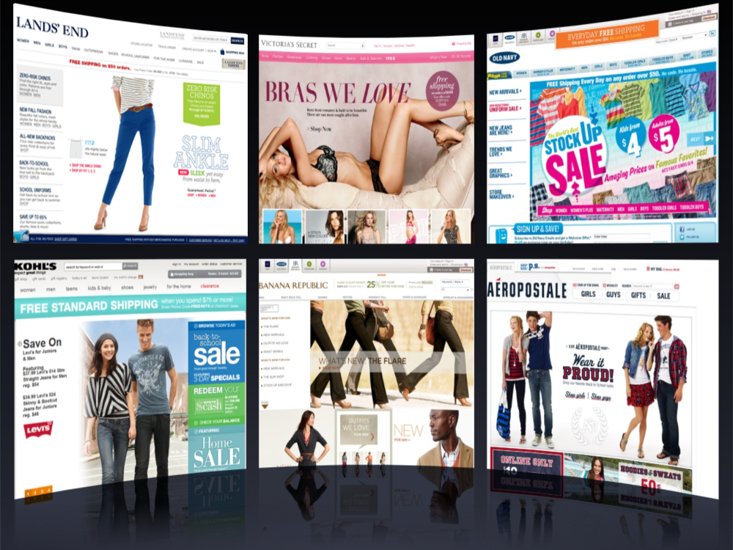
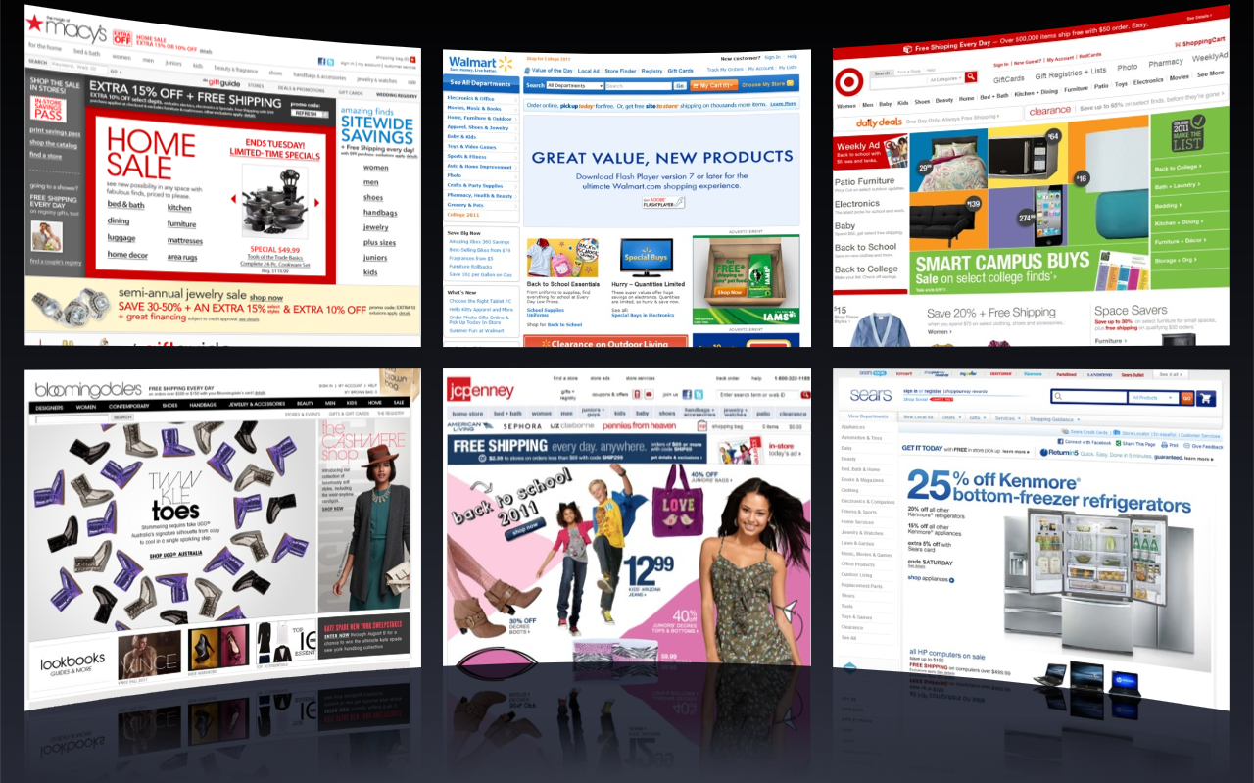
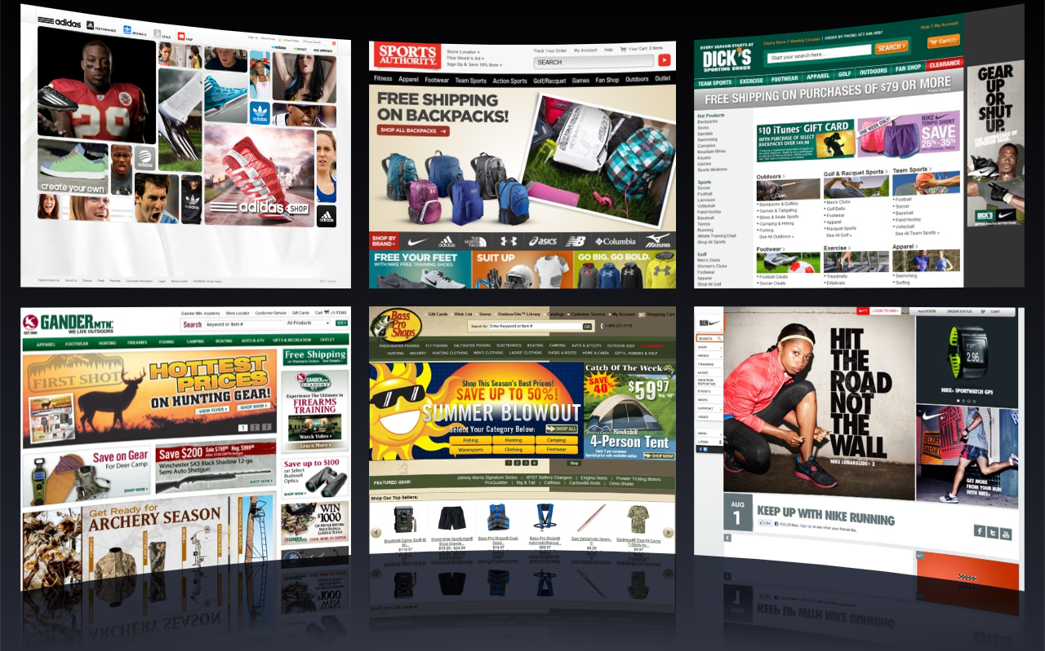
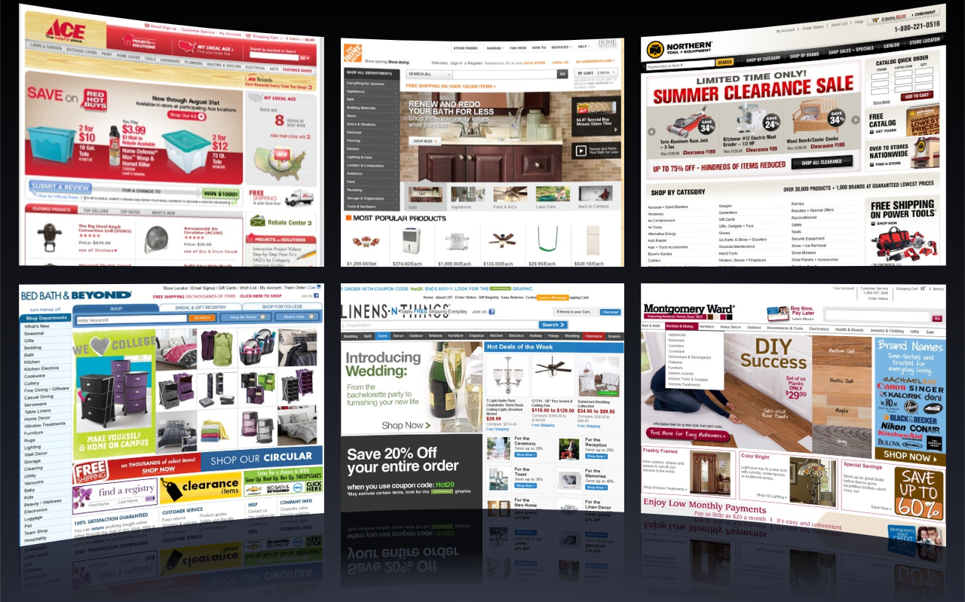
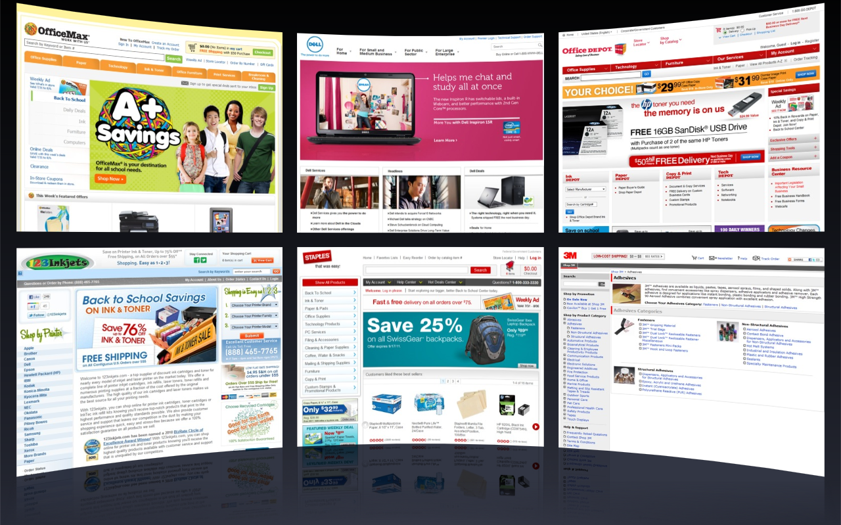
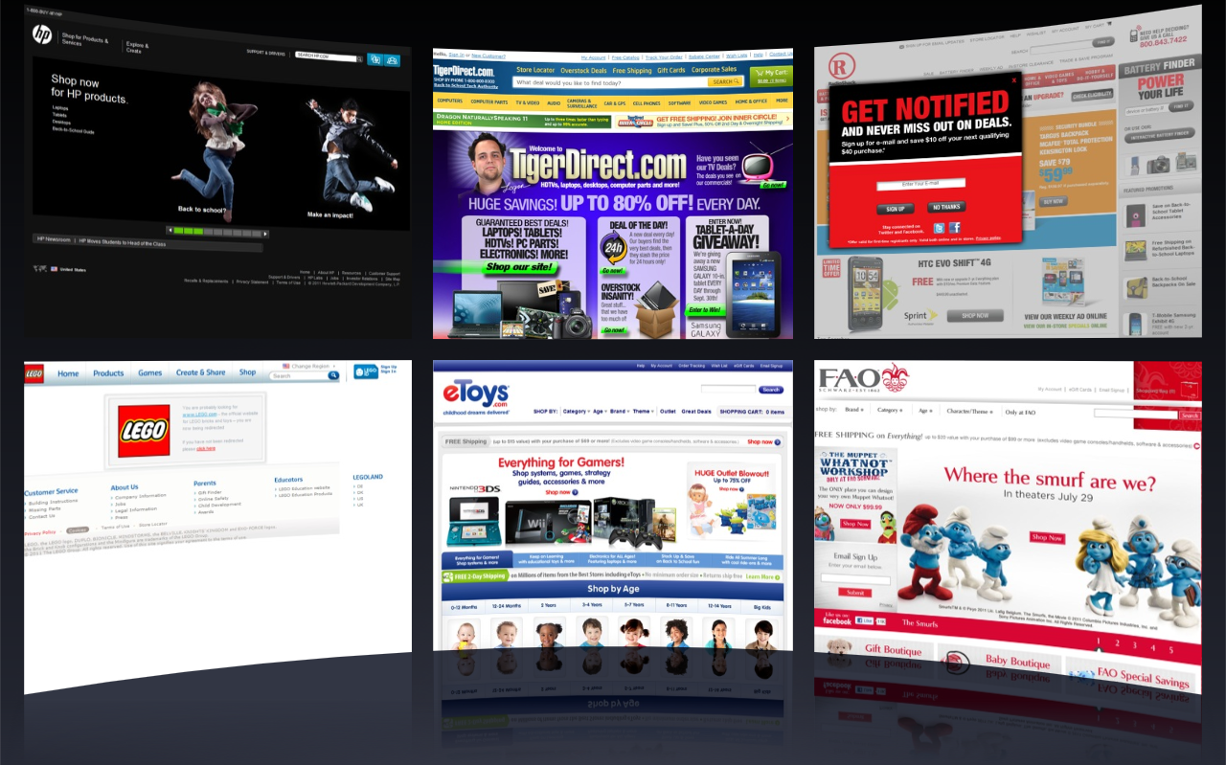










































Apparel
Department Stores
Sports & Outdoors
Home and Garden
Office Supplies
Consumables
Electronics, Toys & Games

Slide 16
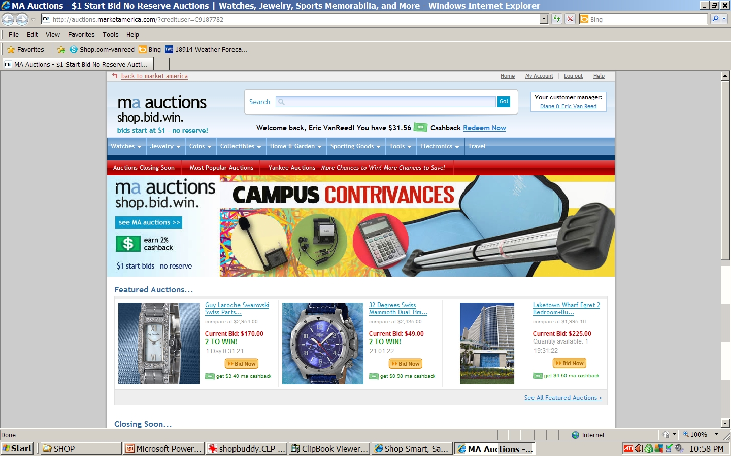

Slide 17
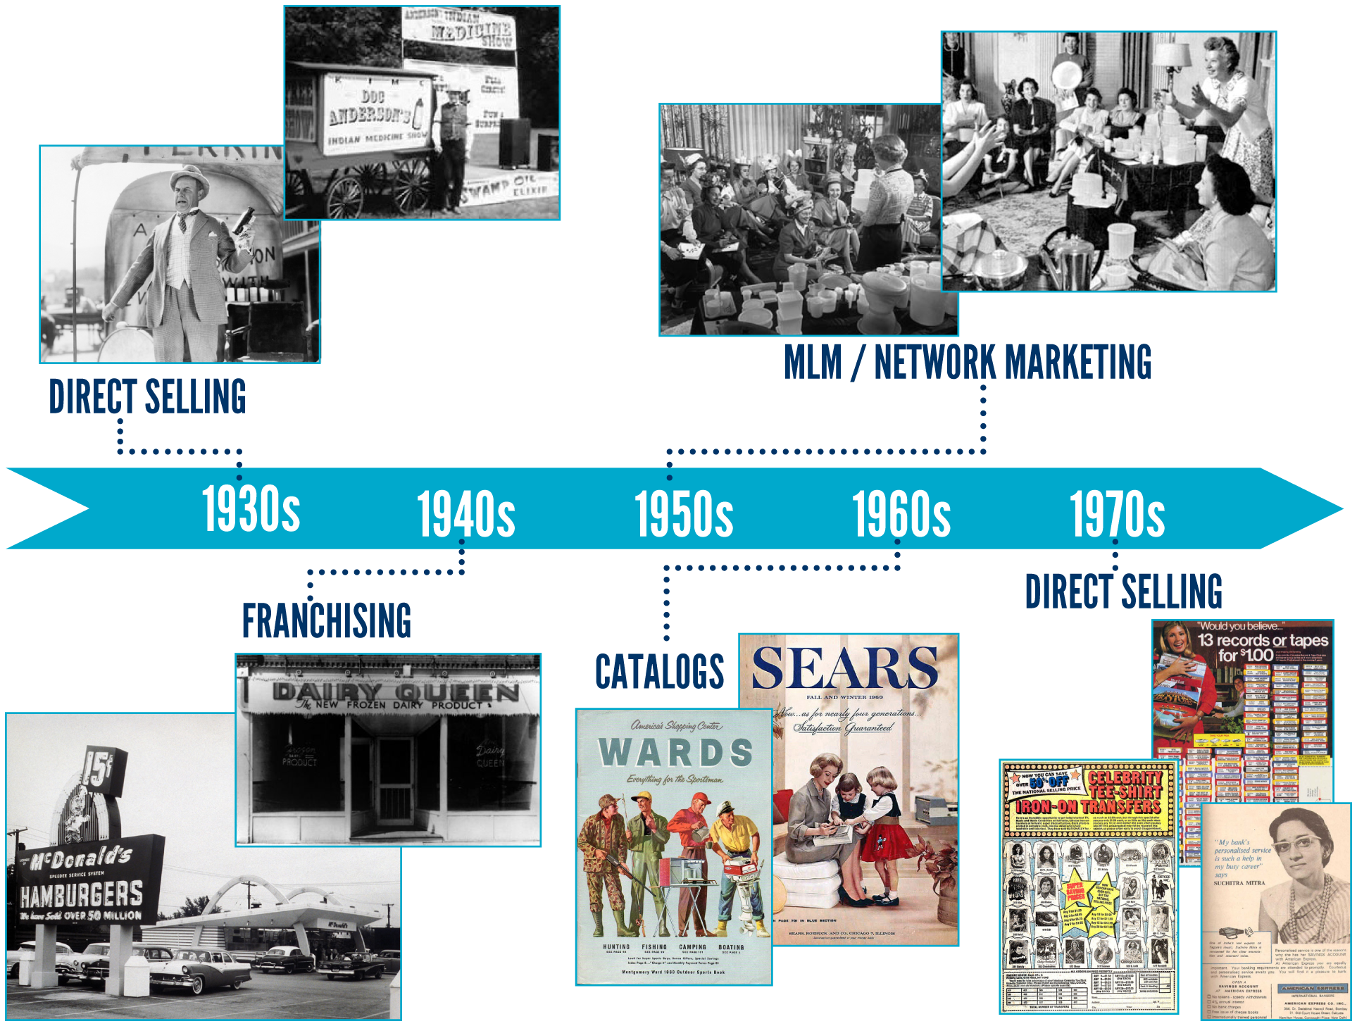
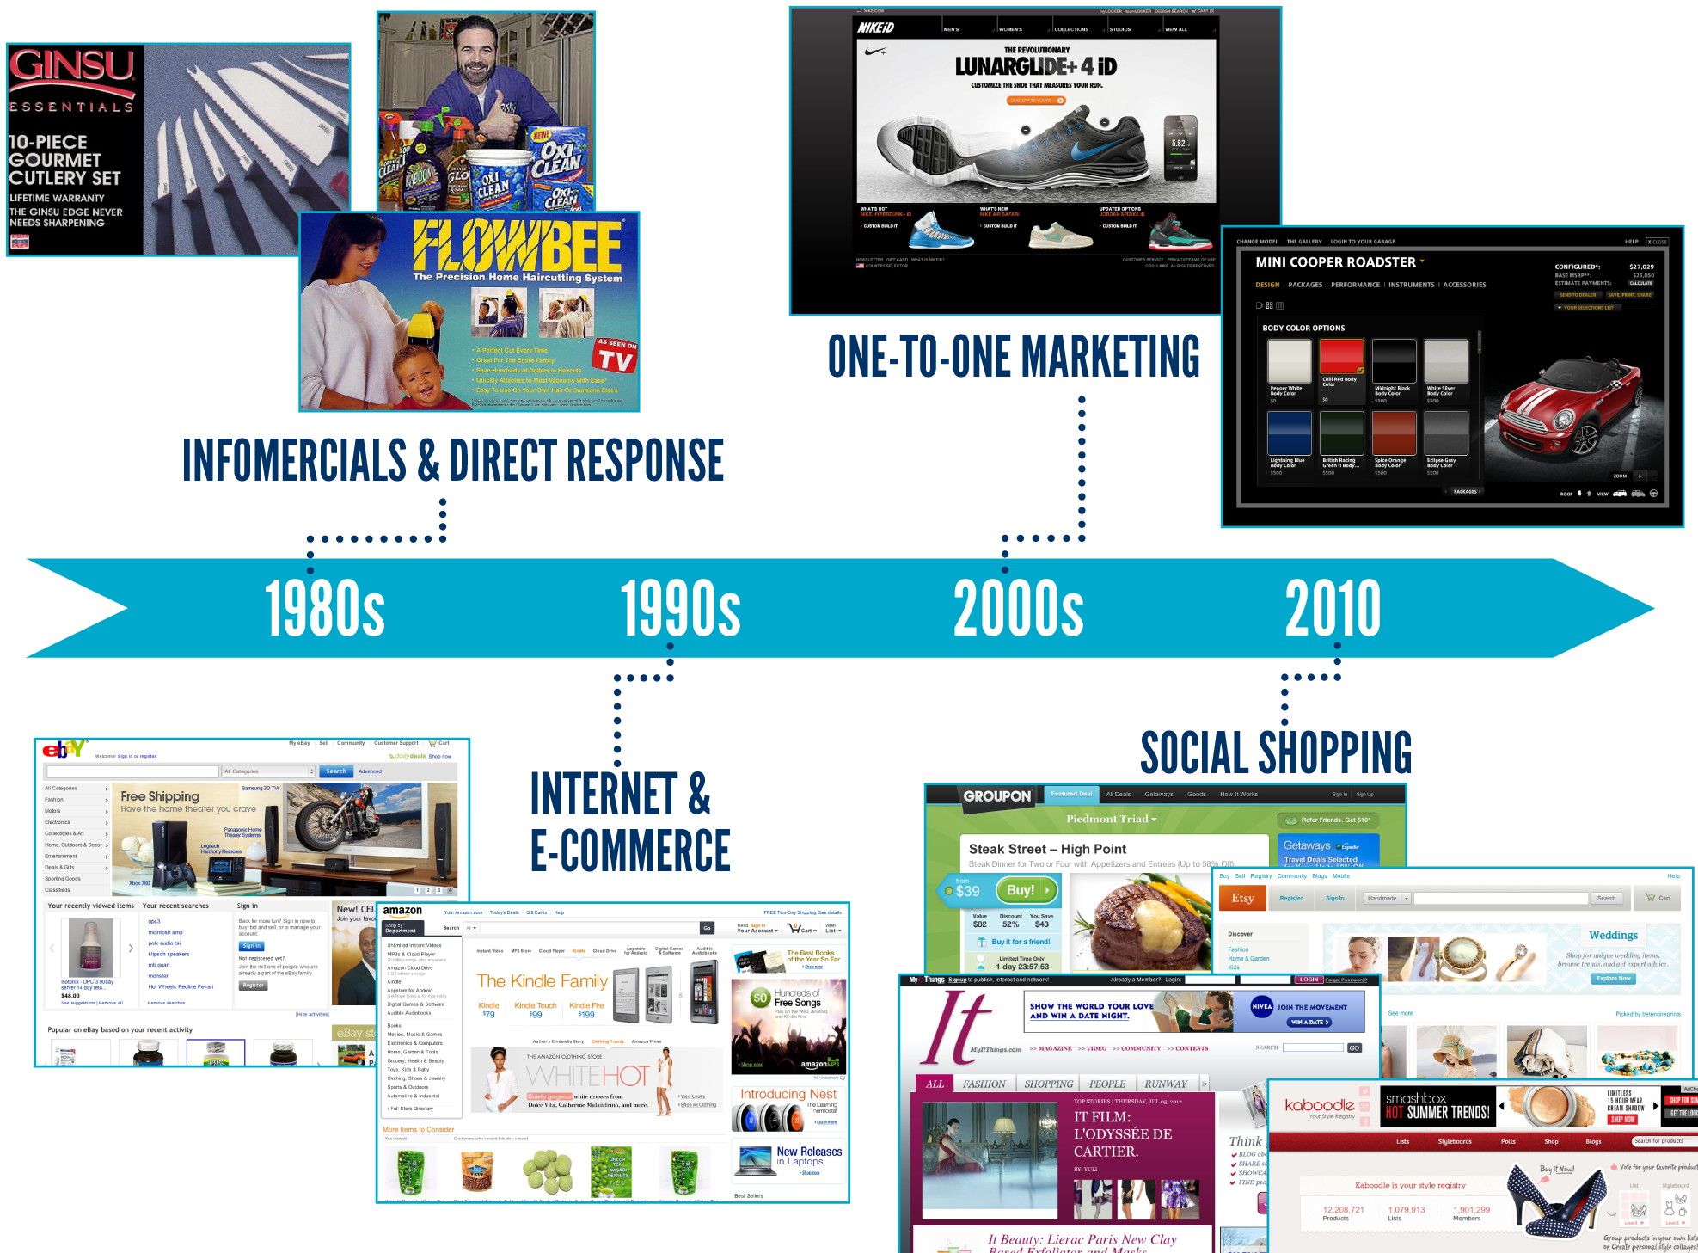

Slide 18




NUTRITION &
WELLNESS
OWNING YOUR OWN BUSINESS
SOCIAL SHOPPING
ONLINE/MOBILE
SHOPPING
• Provides the power of social media and online shopping
• Combines high-tech and high-touch
• Offers the ability to reach millions of customers
• Matches people to products and products to people

Slide 19
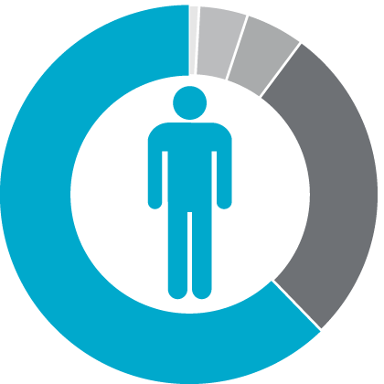
For every 100 people who should have reached the age of 65...
4% Financially Fit
1% Wealthy
5% Still Working
62% Flat Broke
28% Dead

Slide 20








• Compounding efforts
• Encourages teamwork
and support
• Everyone receives 100% credit for sales and volume generated
ALL IN COMPETITION
Real Estate, Insurance, Franchise, Regional Sales/Manager
Notes:
20

Slide 21
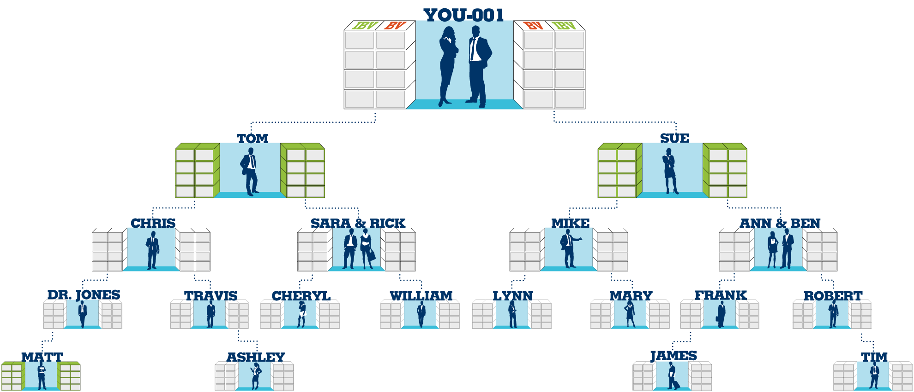


Example: You have an order of 400 BV to place
400 BV
*BV can be placed in BDC’s of individuals that you have personally sponsored

Slide 22
Cashback and retail profit
Volume Accrual – 365 Days
Volume Search to Infinity
Volume Placement
Unlimited Income Potential through additional BDCs
Fast Start Program $399

Slide 23

ma University
Health and Nutrition
Web Development
Weight Management
Cosmetics / Skin Care
Anti-Aging
Internet Sales and Marketing
Financial
Music
Business
nutraMetrix®

Slide 24
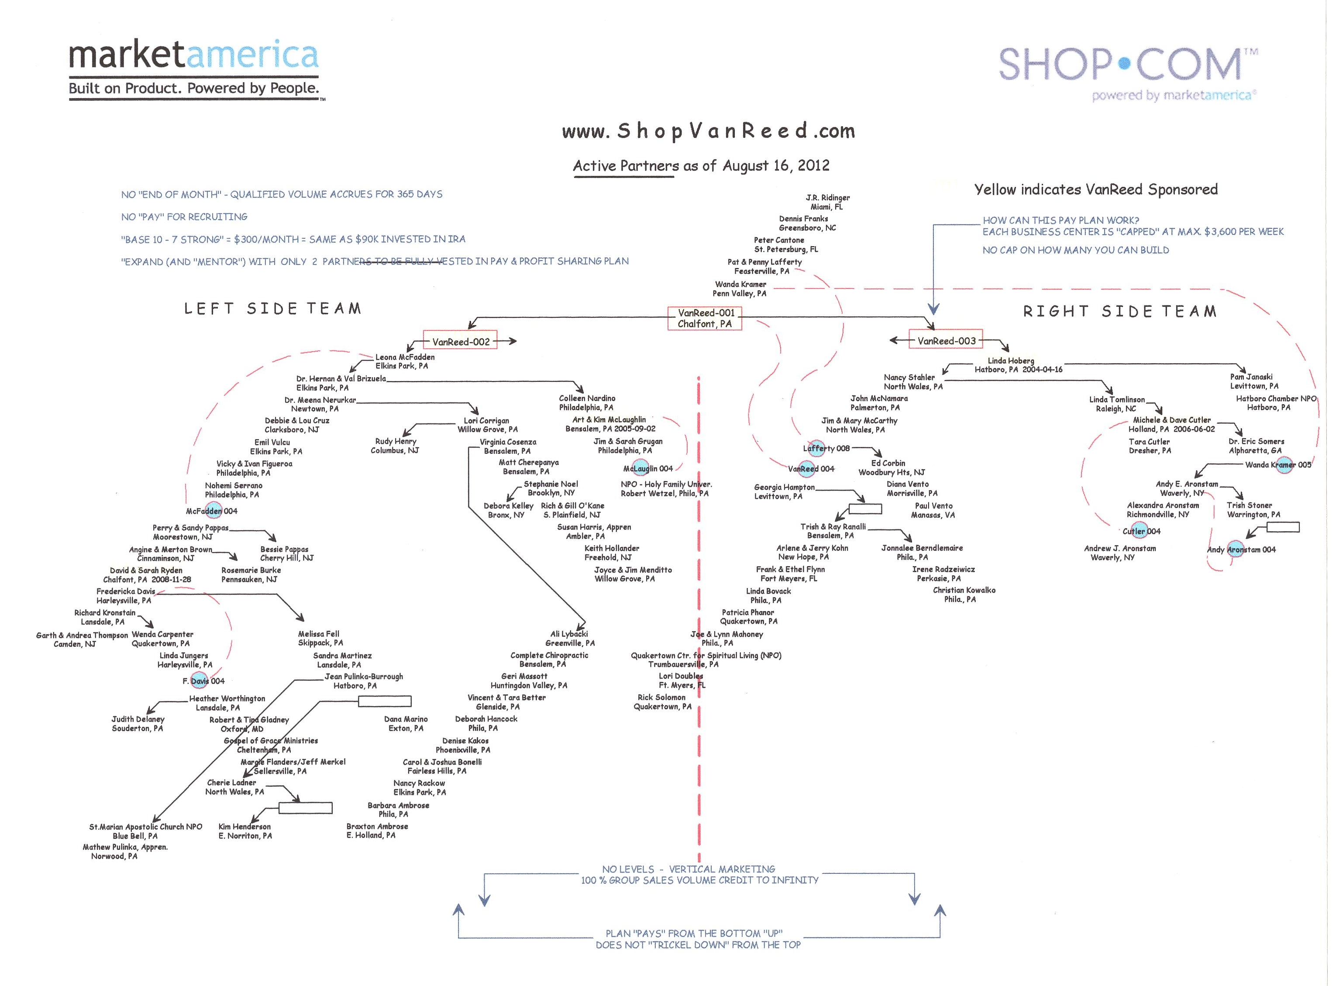

Slide 25

They should…
be well-connected
have great communication skills
want more money or free time
be a self-starter
be disciplined
have integrity

Slide 26
Product Brokerage
Endless Shopping Experience & Portal
Mall without Walls
IBV
Residual Income
MPCP
BV
Internet Marketing & Support
UnFranchise System
Mass Customized Products Transparent Customization Surveys
Preferred Customer System
One-to-One Marketing
Mass Customization

